Slide 1
Release and Iteration Planning
A Module in Agile Fundamentals
Notes:
Plan, execute and report on Agile projects
--------------------------------------------------------------------------------------------------------------------
Welcome to the module Planning the Project. This module is brought to you by ThoughtWorks Studios, maker of Mingle, Cruise, and Twist.
In this module, we’ll explore the practices that help Managers and Project Managers plan, execute, and report on Agile projects.

Slide 2
Questions To Be Answered
What are you going to build?
In what order?
How long is it going to take?
How much will it cost?
What roles and how many do we need?
What else do we need to do?
Notes:
Answered the basic “how long” in Estimating section.

Slide 3
Release Success Criteria
Quantifiable business objectives
ROI
Time
Budget
Scope
Notes:
What is driving the Release?
Time, budget, scope
Market pressure for functionality
Launch of a new project
Are there quantifiable objectives / ROI that need to be met?

Slide 4
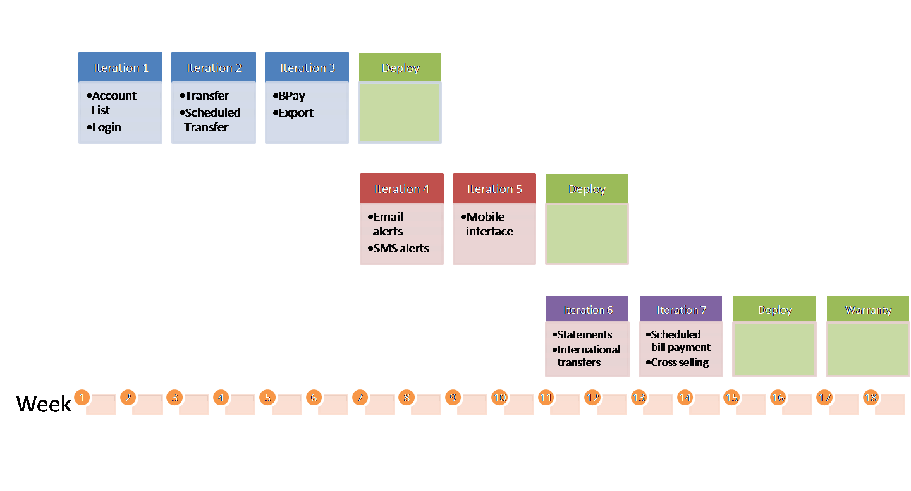
The Release Planning Inputs
Release Planning
Development Capacity (Velocity)
Release Success Criteria
Master Story List
Release Constraints
Dependencies
High level tech architecture
Cross Functional Requirements
Notes:
We need to understand the:
Release success criteria. Time driven, scope driven, $ driven.
Development capacity
Constraints - resource, technical, skill level
Project dependencies
A high level application architecture
Non functional or cross functional requirements – all the ‘abilities
----------------------------------------------------------------------------------------------------------
Like most things in an Agile world, release planning is an iterative and adaptable process. Depending on how the first cut at a release plan may look, more effort may be put into loosening the hold of external constraints (e.g., marketing schedules) or the success criteria for the release may be re-examined (e.g., perhaps another pass through MoSCoW on the story list).
Development Capacity can either be estimated (using a sampling of different story sizes and extrapolating) or determined using a spike iteration.
The success criteria for the project are probably enumerated across the lines of scope (e.g., “we must have these features at least”), cost (e.g., “we only have budget for $200 of development”) and time (“we need to get something to market before the conference starts”).
External constraints can have a big influence on the release plan and are often in the shape of project dependencies (i.e., integrating with Application X which only releases each quarter).
A release story wall can be used to show the distribution of stories between releases and between iterations within a release. Obviously a release plan is a high level artifact, so the expectation should be set to allow considerable movement at this level.
Low: 2 min
High: 5 min

Slide 5
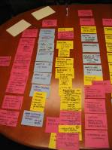
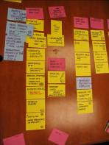
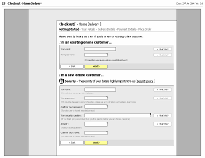
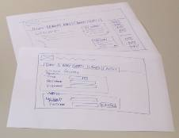

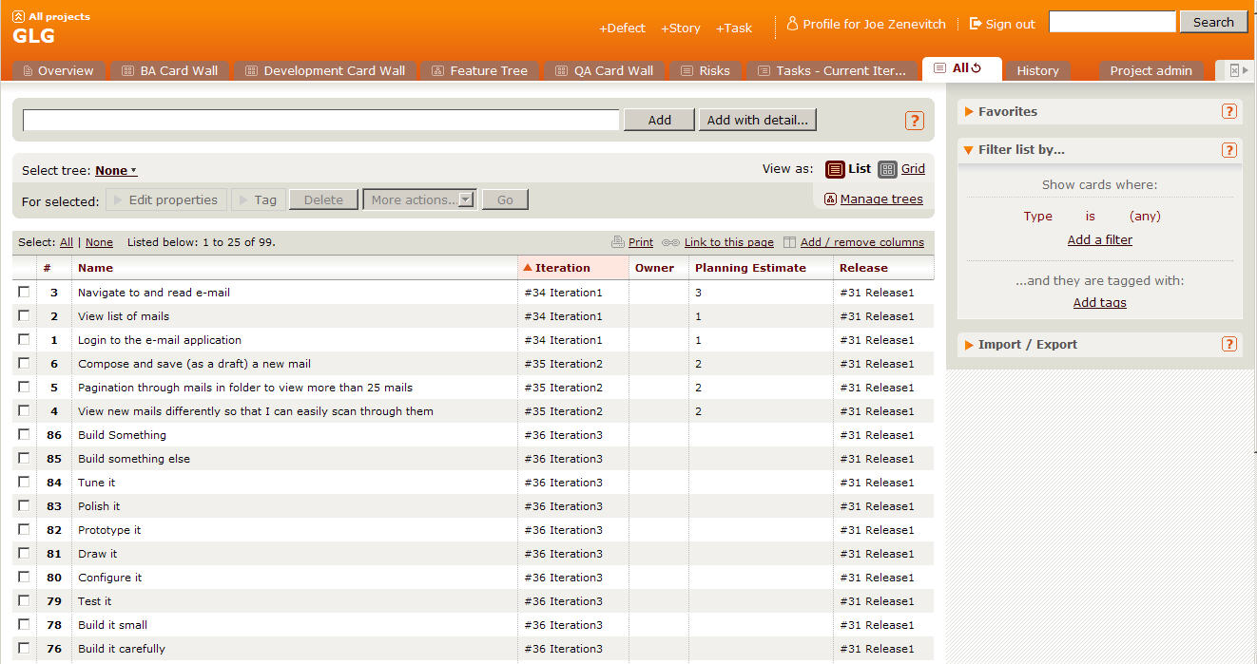
Initial Story List
As-Is & To-Be Process modelling
Low fidelity prototyping
Focused small group analysis
Initial story list
Notes:
The story is the unit of work we will measure to determine approximate length and cost of project.
We conduct many workshops to create stories and ultimately the MSL.
We go in depth on each of these items and more to get to our initial story list.
We should have done all of this already in the previous sections.
Low: .5 min
High: 2 min

Slide 6

Prioritize the stories

Slide 7
MoSCoW Prioritization
Won’t Have
Could Have
POINTS
Should Have
Must Have
Notes:
Most likely the total bucket of stories will can be categorized into these four buckets. For the purposes of planning the first release, the MMR should be the Must Have bucket.

Slide 8
Span Planning
Goal
Goal
Goal
Activity
Activity
Activity
Activity
Time
Story
Story
Story
Story
Necessity
Story
Story
Story
Story
MMF
Story
Story
Story
Story
Story
Story
Notes:
There are many versions of this approach, but in essence its about laying out the stories so that you can see where the MMF is.
The next slide shows an example from Jeff Patton
When prioritizing stories and building the Release Plan, consider the following:
Business Value – does this contribute to the ROI. What is the Minimum Marketable Feature set?
Risk – does the item carry either technical or functional risk
Usage – How often is this feature set used and by how many different roles/personas?
Compliance – is the feature set required to avoid possible financial penalties?
Dependencies - is this feature set dependent on or required by another team?
Simplicity – do we need all parts/stories for this feature set? Or can we go Live with a subset?

Slide 9
Prioritize Your Stories
Get back into your groups
Sort your stories into priority order
What is the MMF set of stories
Can you do them all?
Notes:
Prioritize stories into Minimum Marketable Features (MMF)

Slide 10





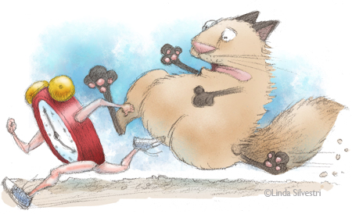
What Are Your Constraints?
Quality?
Scope?
Resources?
Budget?
Time?
Scheduling?
Notes:
Unconstrained Model
Tell us how long it will take to build this
Constrained Models
Tell us what we can build and stay within budget
Tell us how long it will take to build this with the staff we have
What can we get built in a certain timeframe
A time constrained project is one where the first release must be delivered by a certain date
A resource constrained project is where for whatever reason you can’t add more people, which could be because there is a budget constraint
But, budget could also be a constraint on how long the team can work for
A scope constraint is where a certain scope must be delivered for some reason (perhaps compliance reasons)
Low: 2 min
High: 5 min

Slide 11
Dependencies
Cross project dependencies
Departmental dependencies
Staffing dependencies

Slide 12
Cross-Functional Requirements
Execution
Evolution
Auditability
Authentication
Authorization
Availability
Performance
Regulatory
Security
Portability
Extensibility
Localization
Scalability
Usability
Notes:
Another type of requirement that has to be captured on all projects is the NFR.
We all know what these are. They creep up on us near the end.
Execution qualities of a system – security, usability
Evolution qualities – testability, extensibility, scalability
NFRs are typically technical or usage based and usually follow policy or documented guidelines
Make them cards.
Its work you have to do.
HAVE SOME DISCUSSION HERE as to what you can do about these.
Technique-
Send out a questionnaire first for folks to do their homework.
How many transactions/users/countries/whatever?
Response time?
What platforms?
Compliance
Low: 5min
High: 15min

Slide 13
In Summary
Prioritizing stories
Minimally Marketable Features
Span Planning
Other activities

Slide 14
What goes into each release?
The rest – 520 pts
MMF = 1,297pts
Priority 2 – 873 pts

Slide 15
Iteration slotting
Notes:
Put the stories into iterations, with the total points in each iteration totaling the estimated velocity (earlier calculation).
Should be some sense of a theme in each iteration (get sign-on working, deliver reports, credit card payment, etc.), along with a prioritization of business value.
Deliver high value first.

Slide 16
Iteration Planning
Using the iteration length you decided upon earlier.
Use your stories, their estimates, estimated velocity, and prioritization
Arrange the stories in priority order in iterations
Notes:
Develop 3 or 4 iterations.
This conversation may lead to “how long is an iteration” – for the animal, each iteration is 4 minutes

Slide 17
Questions?

